Slide 1
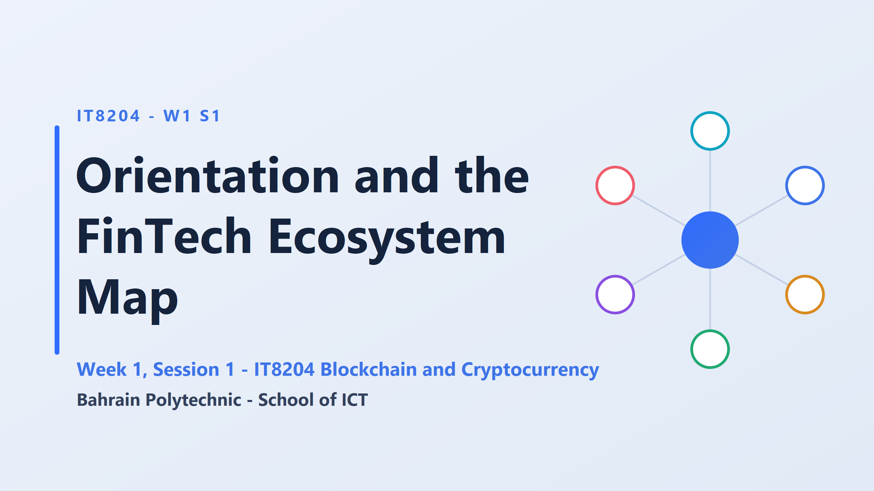
Nobody will be asked to write code here.
The skill being built is judgement: looking at a blockchain product and saying whether it makes business sense, and whether a regulator would allow it to run.
who has heard the word Bitcoin in the past month, in a news report, a conversation at home, or an advertisement?

Slide 3
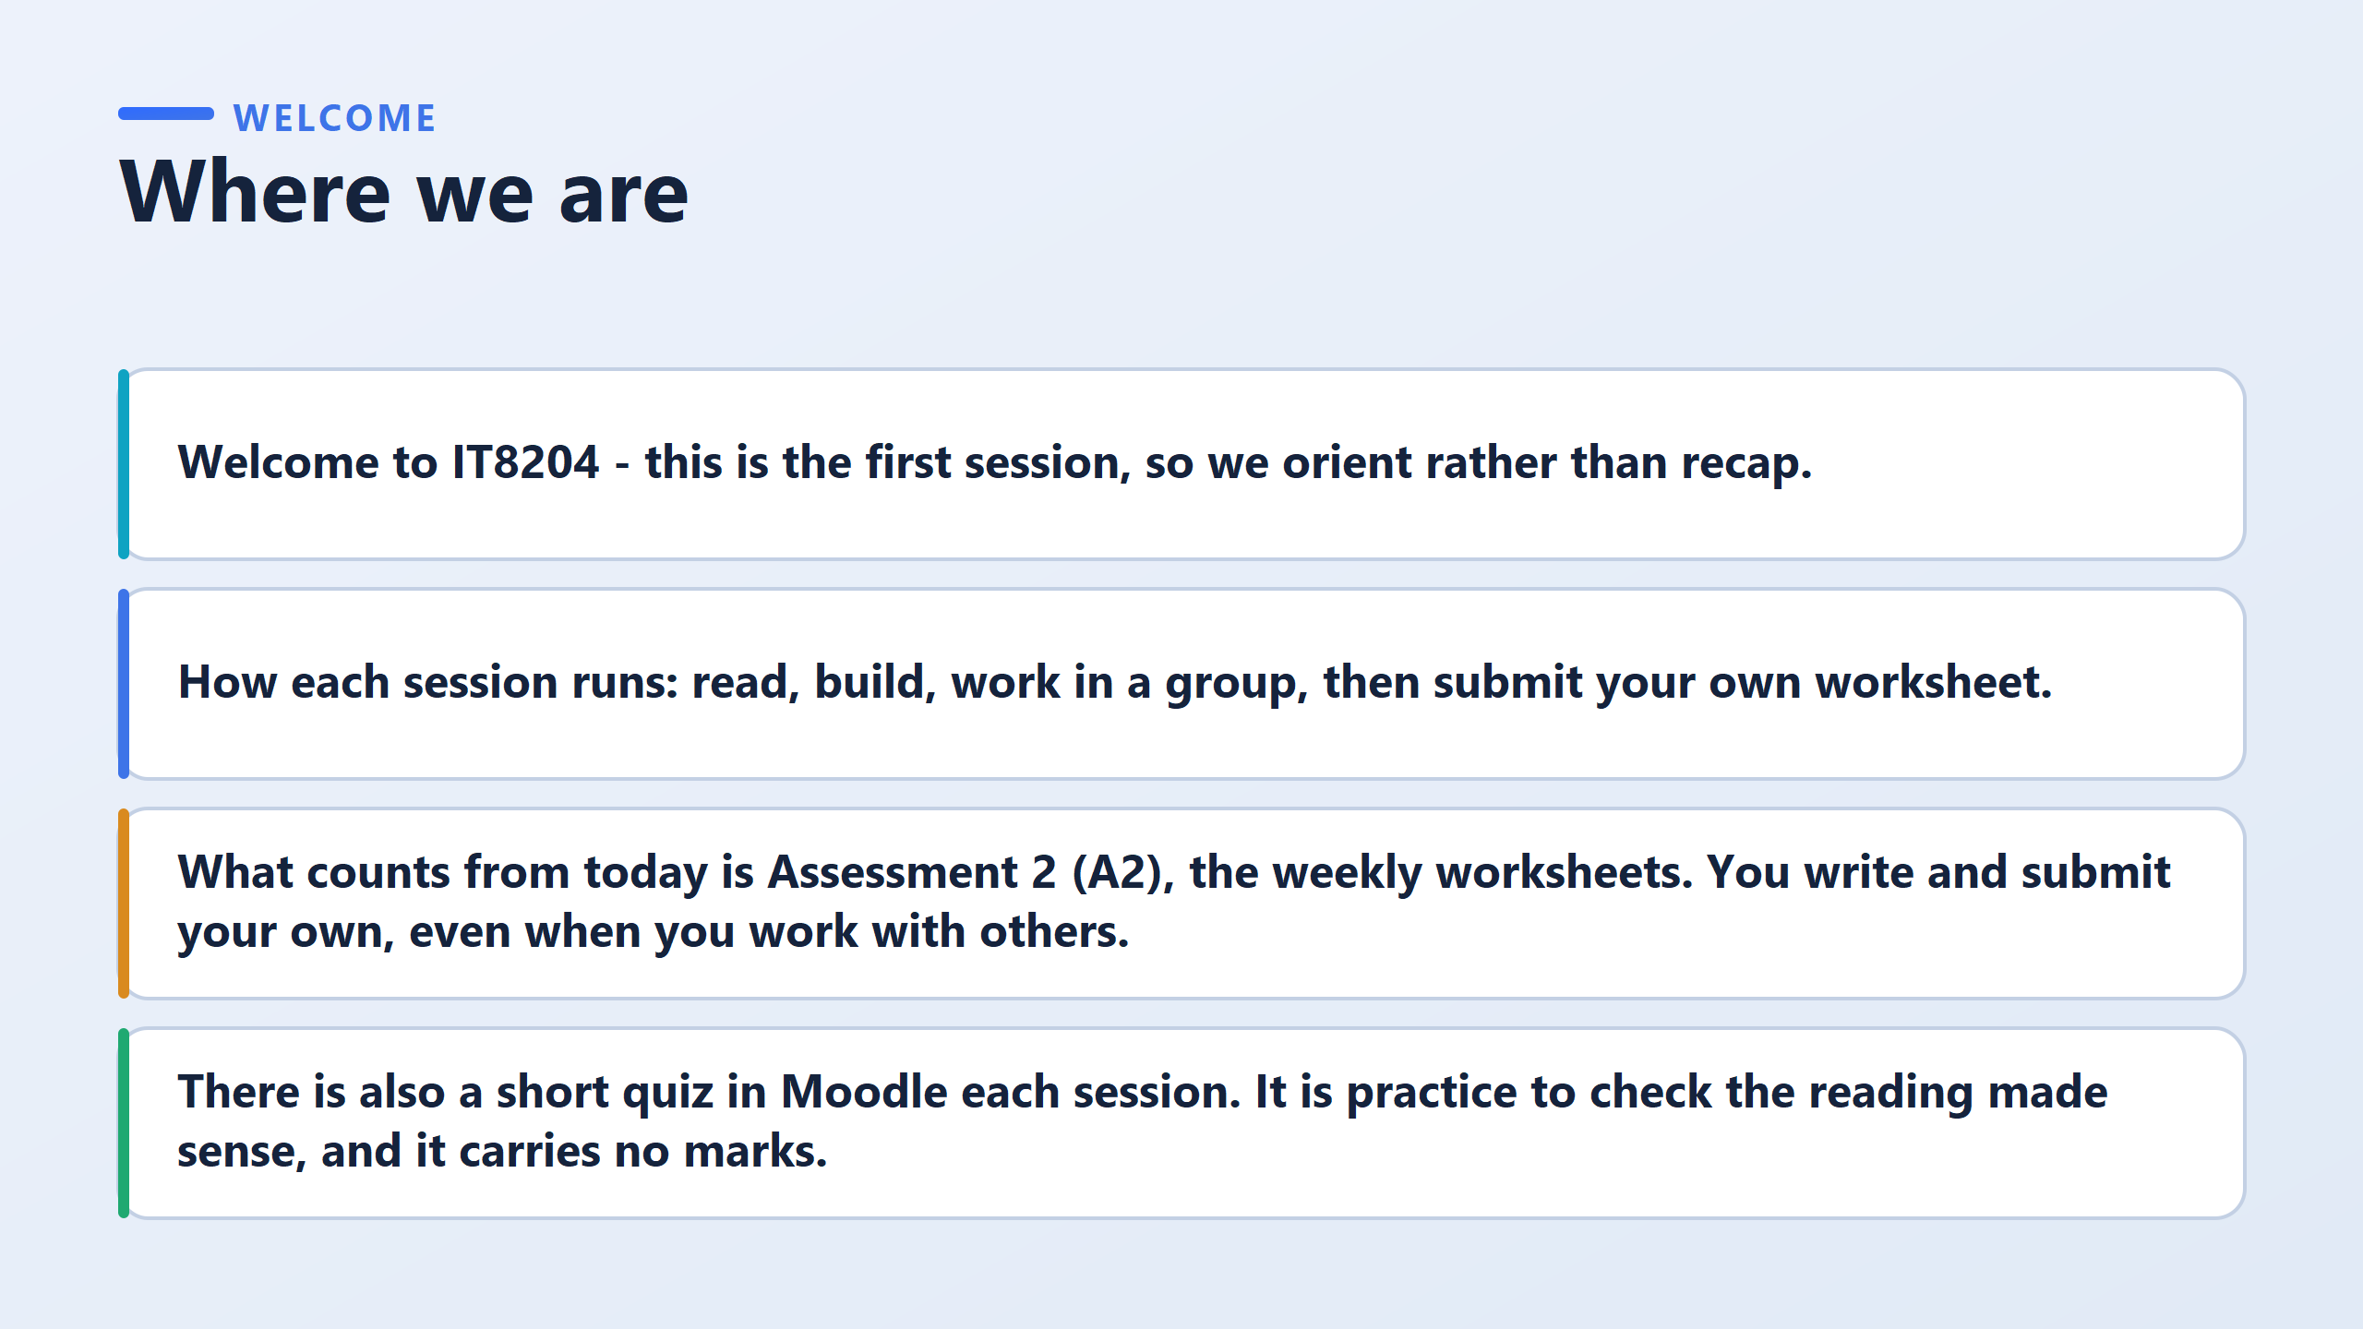

Slide 4
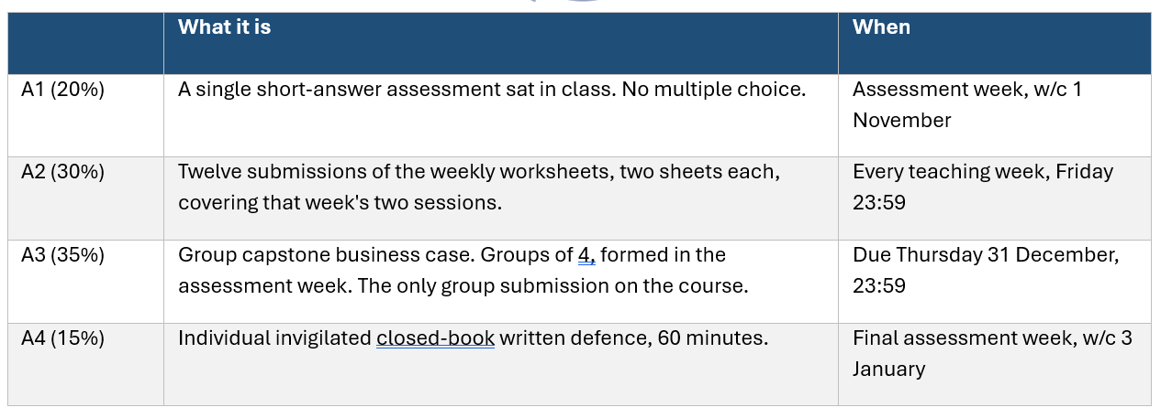
The four assessments

Slide 5
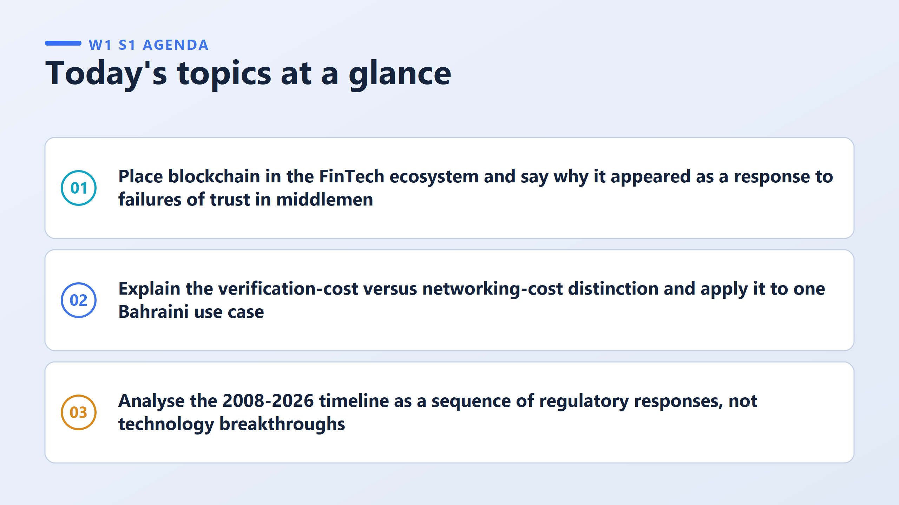

Slide 6
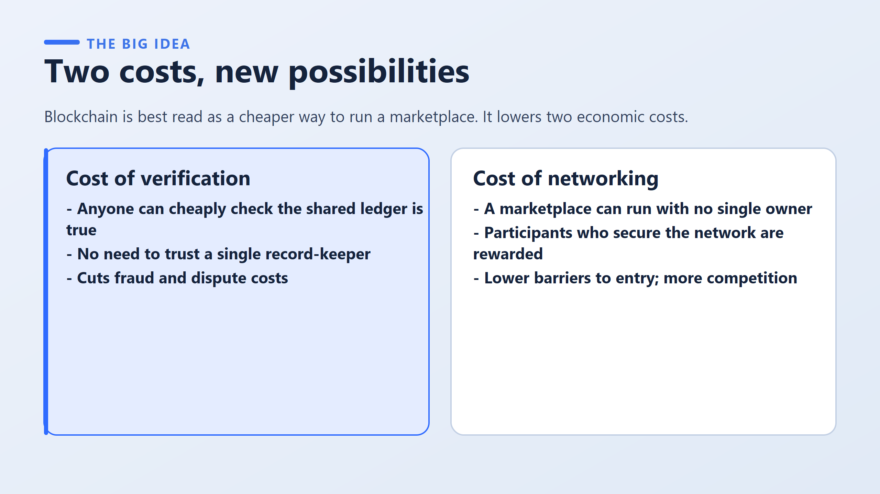
A concrete example. Two people in Manama agree to sell a used car. The verification cost is the trip to confirm that the seller really owns it. The networking cost is quite separate. It is the fact that a used-car marketplace had to be built, staffed and funded before those two strangers could find each other at all. Which of the two an online marketplace solved, and which it did not. The answer is that it solved the second and barely touched the first, which is exactly why buyers still insist on seeing the papers.
The single idea: blockchain is not a magic trust machine. It is a way of reducing cost, and there are exactly two costs it reduces.

Slide 7
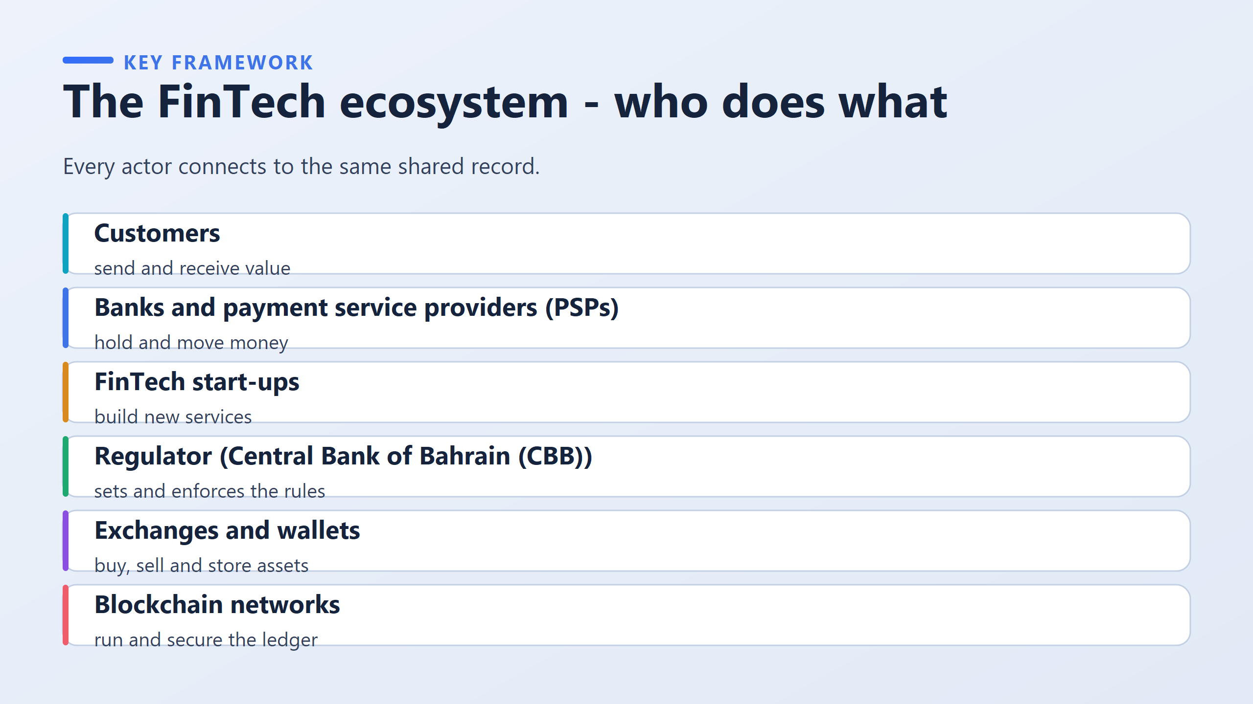
PSP: a licensed firm that moves money for merchants.
The regulator sits at the end or at the start? Specifically in Bahrain?
It decides who is allowed to be each of the other actors on this slide. No license, no business.

Slide 8
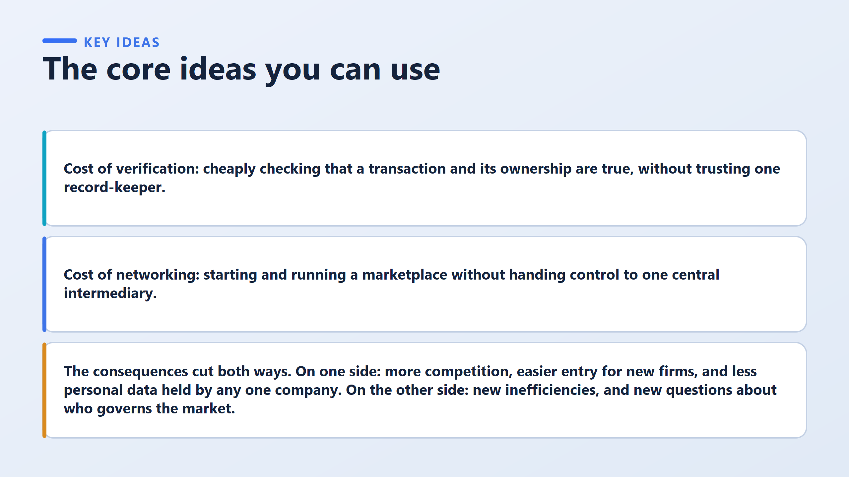
Cheaply matters, because checking was always possible; it was simply expensive. Transaction and its ownership are two different claims: that the transfer happened, and that the thing transferred was the sender's to send.
The key phrase is handing control to one central intermediary. Notice that this is a statement about who is in charge, not about how fast the system runs. Speed appears nowhere in it.

Slide 9
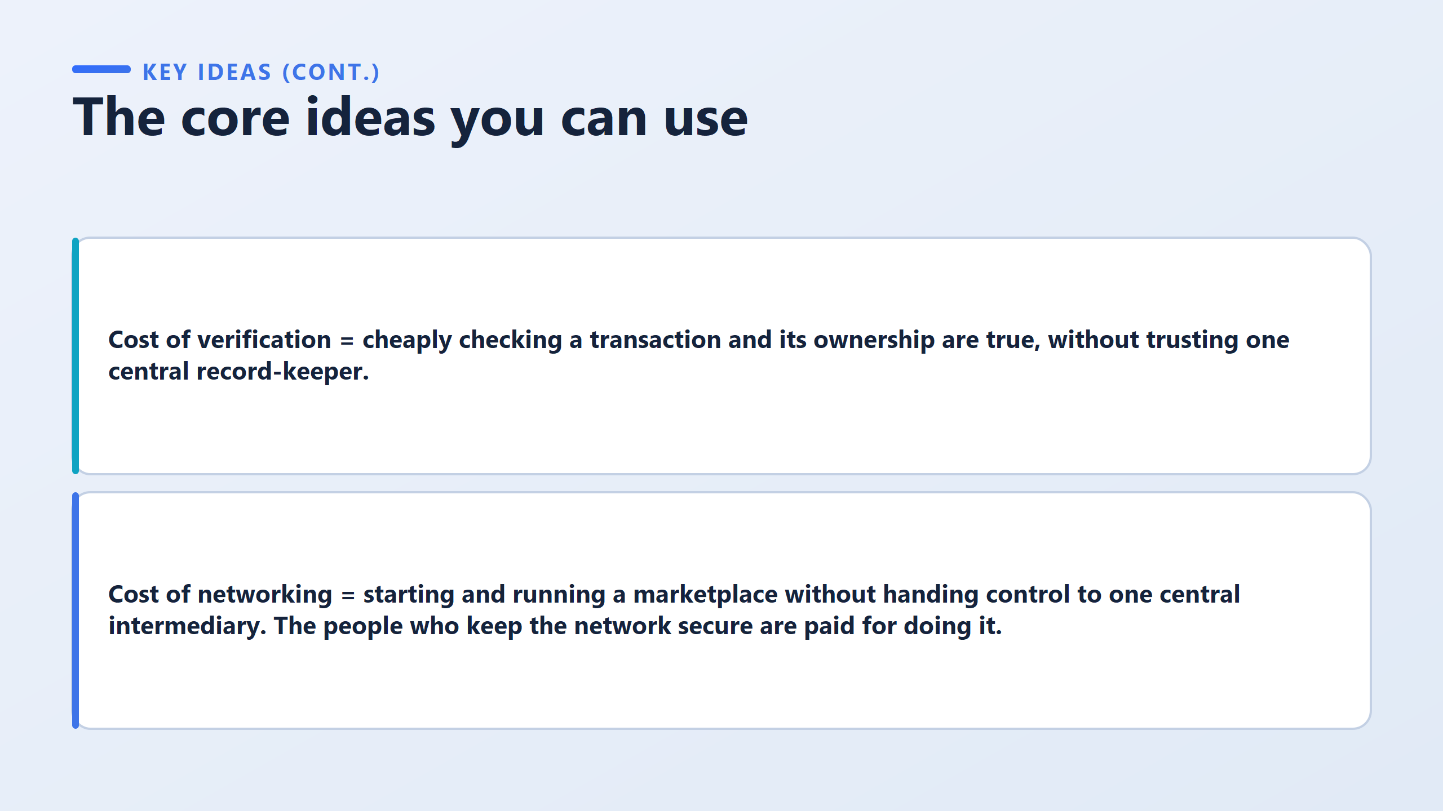
If nobody owns the marketplace — no company;
then who's actually running the servers? Blockchains aren't magic; they run on real computers, using real electricity, and someone has to keep them online 24/7.
In a normal company, you'd just... pay employees. But there is no company here.
So who foots that bill?
The answer: the network pays for its own upkeep, built into its rulesInstead of a company hiring staff and paying them a salary, the blockchain's own code offers a reward to anyone who volunteers to do the work of maintaining the shared record. This is usually called mining (Bitcoin-style) or staking (newer systems like Ethereum).

Slide 10
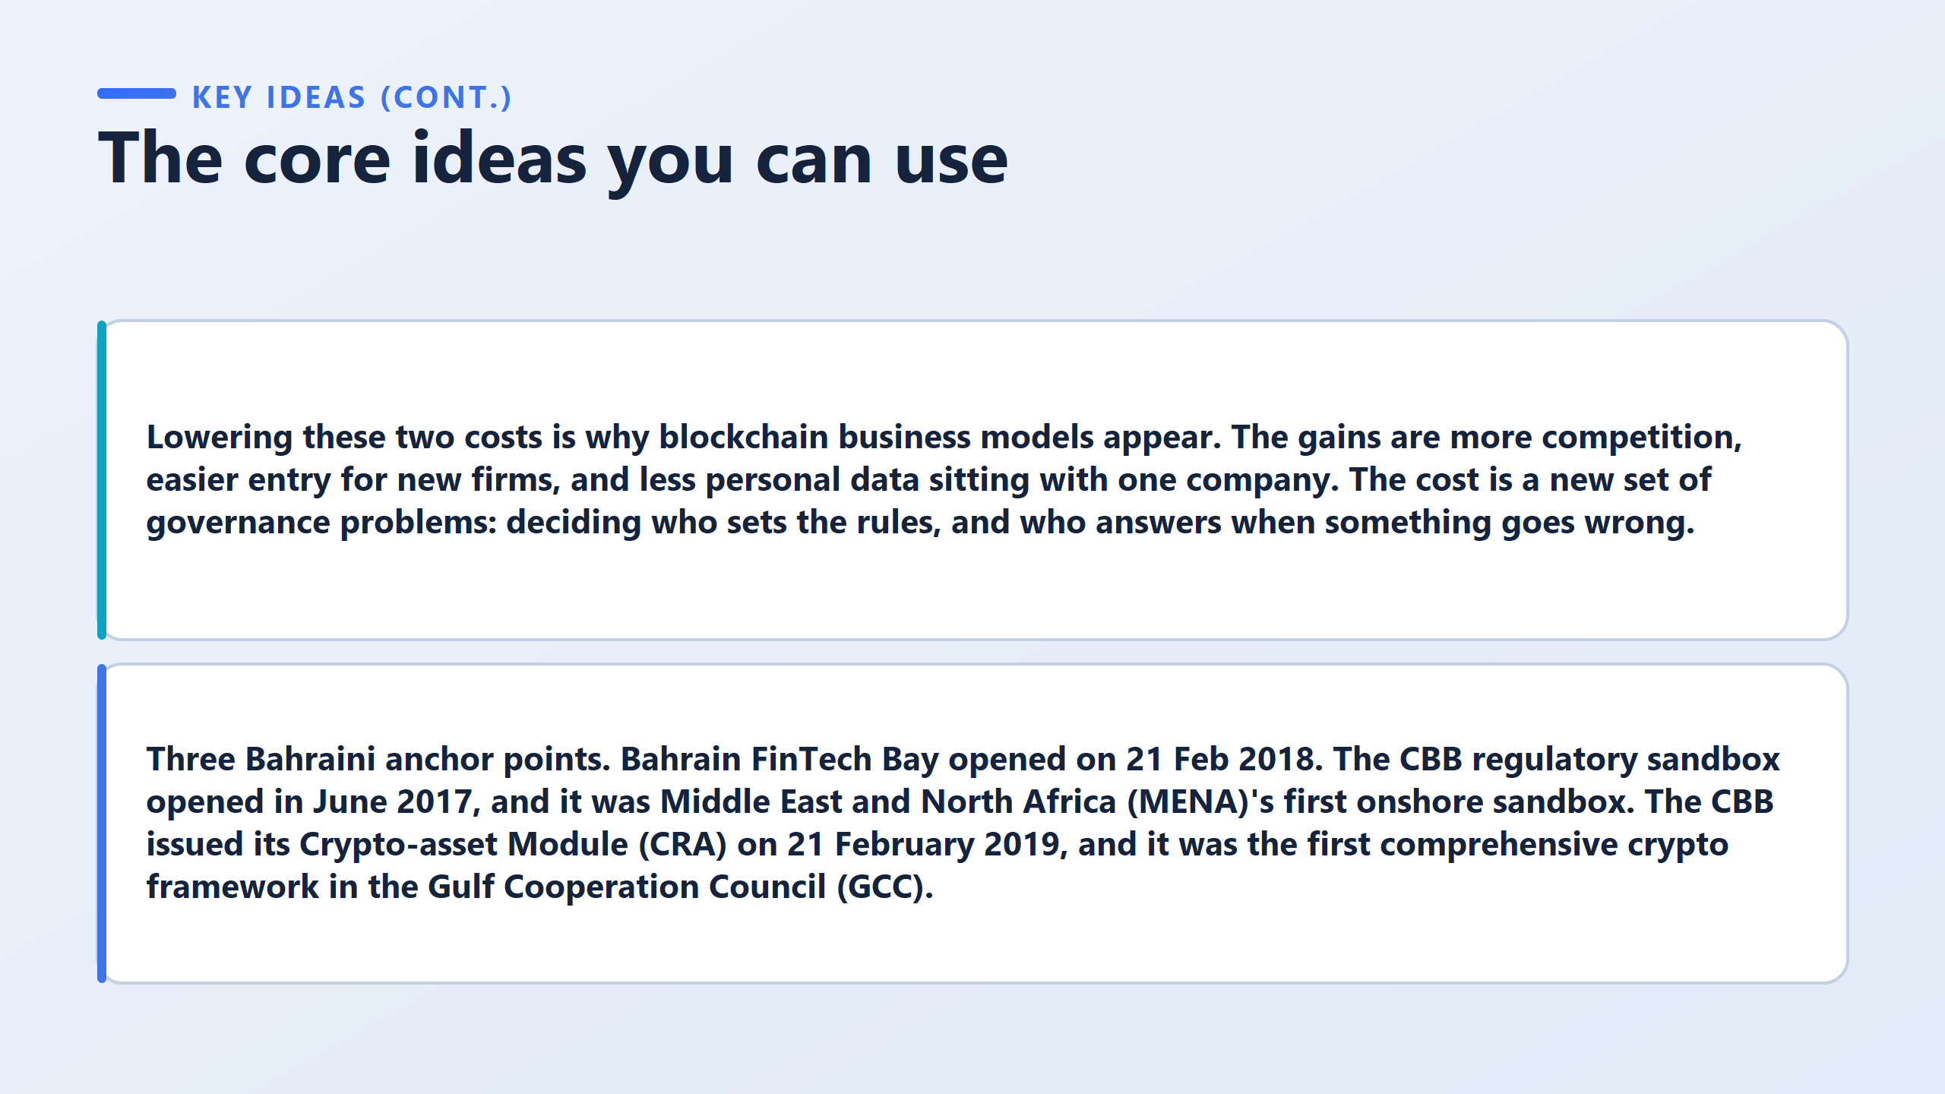

Slide 11
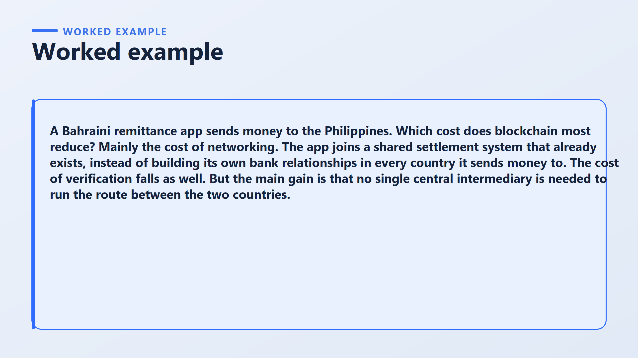
?

Slide 12
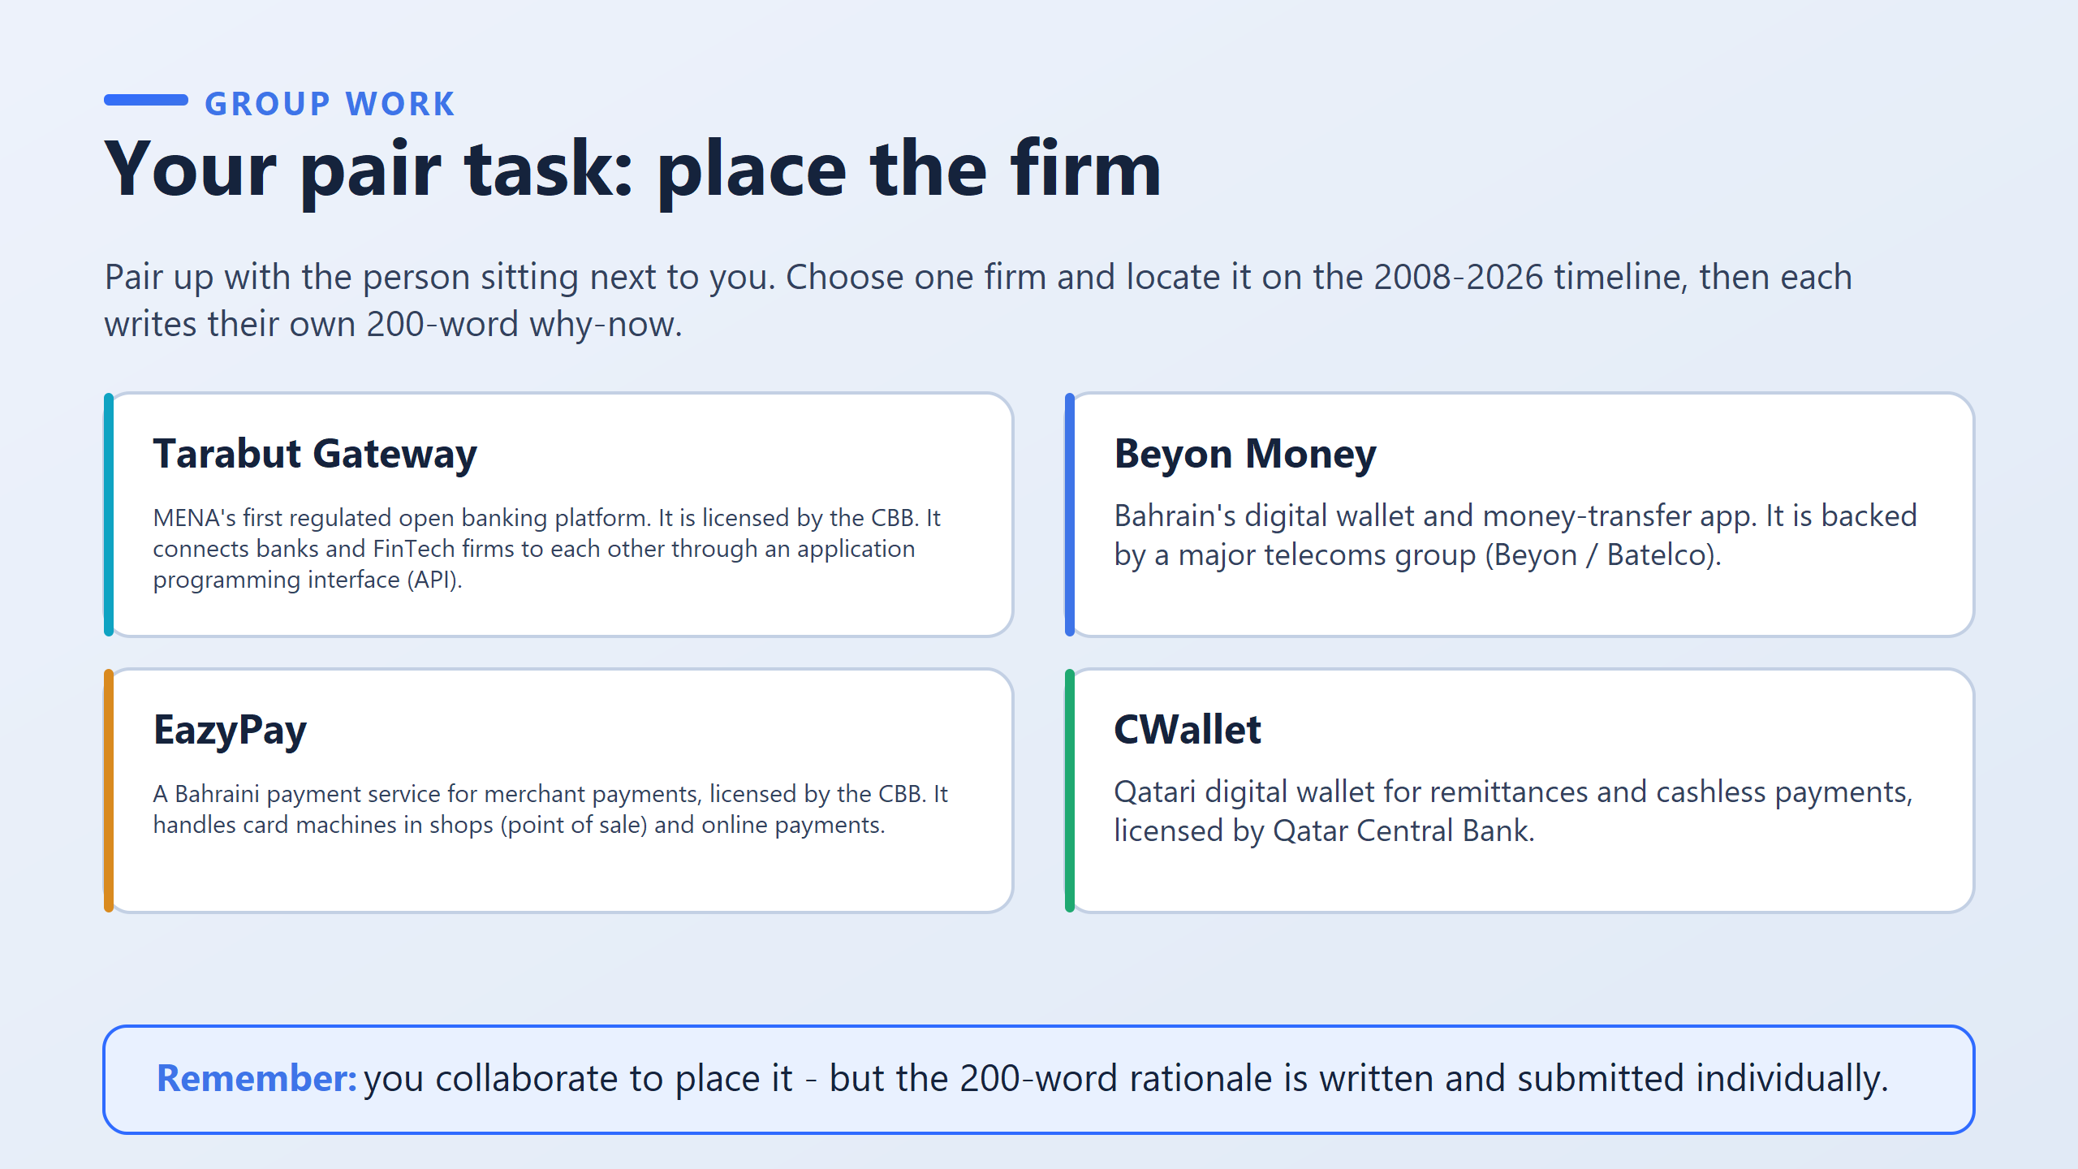
job is to place it on the 2008 to 2026 timeline they read earlier, then argue why it appeared when it did.

Slide 13
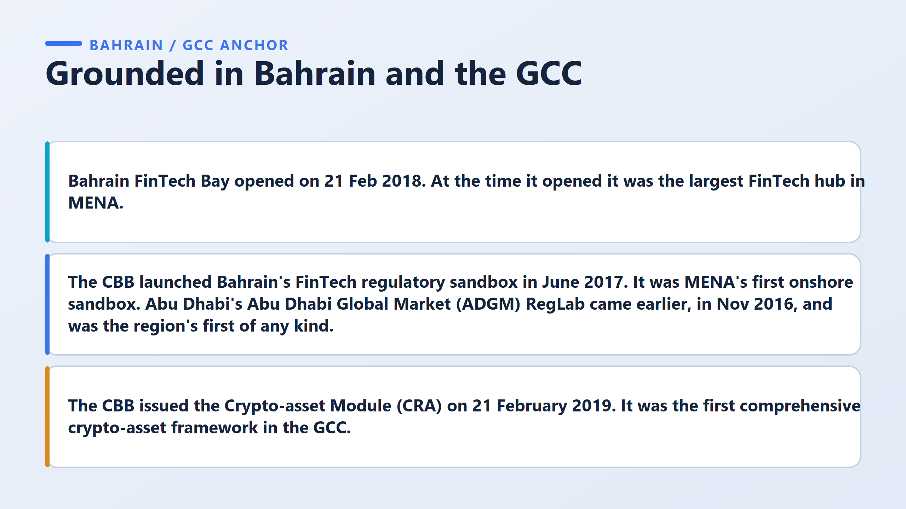

Slide 14
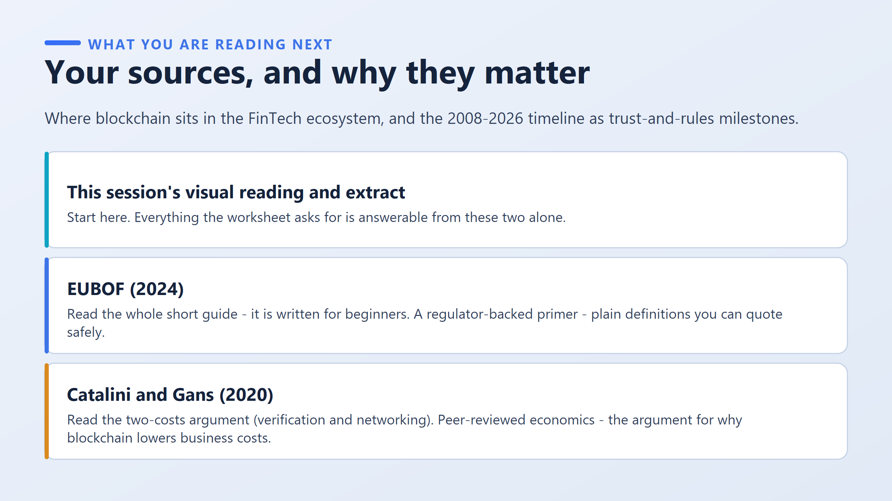

Slide 15
